Slide 1
PERFORMANCE EVALUATION
OF CPI FOR DIFFERENT
INSTRUCTION MIXES
IN A RISC PROCESSOR
MES College of Engineering, Kuttippuram | Dept. of AI & Data Science
Mini Project Report | B.Tech AI & DS | 2025–2026
Guide: Sherik K. K., Assistant Professor, Dept. of AI & DS
IF
ID
EX
MEM
WB
5-STAGE RISC-V PIPELINE
01

Slide 2
TEAM MEMBERS
Project Team
MES24AD — Batch 2024 | Dept. of Artificial Intelligence and Data Science
01
FATHIMA MINSHA
02
FARHA FATHIMA
03
FATHIMA HAFNA SHERIN
Register No: MES24AD019
Register No: MES24AD014
Register No: MES24AD018
04
FATHIMATH NAJA
05
HASNA TK
06
RIDHIN MUHAMMED
Register No: MES24AD023
Register No: MES24AD025
Register No: MES24AD039
02

Slide 3
TABLE OF CONTENTS
Overview
Topics covered in this presentation
Introduction
System Architecture
01
02
CPI, pipelining, instruction mix concepts
5-stage RISC-V pipeline design & hazard types
Experimental Methodology
Program Descriptions
03
04
Program design & simulation setup
Arithmetic, Memory & Control-heavy programs
Experimental Results
Analysis & Conclusion
05
06
CPI, IPC & cycle data from Ripes
Hazard comparison, key findings & summary
03

Slide 4
INTRODUCTION
What is CPI and Why Does It Matter?
Cycles Per Instruction — the core metric of processor performance
Instruction Pipelining
CPI — Cycles Per Instruction
Multiple instructions execute simultaneously across IF, ID, EX, MEM, WB stages. Ideal CPI = 1.0 (one instruction per cycle).
Average clock cycles to execute one instruction. Calculated as: CPI = Total Cycles ÷ Instructions Retired.
Instruction Mix
Project Objective
Proportion of arithmetic, memory, and control instructions varies by program. Each type interacts differently with the pipeline.
Measure how arithmetic-heavy, memory-heavy, and control-heavy programs differ in CPI on a 5-stage RISC-V pipeline using Ripes simulator.
04

Slide 5
SYSTEM DESIGN
5-Stage Pipeline Architecture
RISC-V processor stages and their functions
IF
ID
EX
MEM
WB
Instruction Fetch
Instruction Decode
Execute
Memory Access
Write Back
Fetches next instruction from memory using Program Counter (PC).
Decodes instruction, reads register values from register file.
Performs ALU operations or computes memory addresses. Branch conditions evaluated here.
Reads from or writes to data memory. Active only for LW and SW instructions.
Writes computed results back to destination register, completing the instruction.
SIMULATION CONFIGURATION
Simulator
Processor
Hazard Handling
Memory Model
Ripes — RISC-V Visual Simulator
5-Stage Pipeline (RV32IMC)
Data Forwarding + Pipeline Stalls
Harvard Architecture (separate I/D memory)
05

Slide 6
PIPELINE HAZARDS
Instruction Mix vs. CPI Effect
How each instruction type impacts pipeline efficiency
ARITHMETIC
(ALU)
MEMORY
(Load/Store)
CONTROL
(Branch/Jump)
PIPELINE IMPACT
PIPELINE IMPACT
PIPELINE IMPACT
Executes in EX stage using registers only. No memory access.
Requires MEM stage. Load-use hazards force pipeline stalls.
Branch resolved in EX stage. Wrong-path instructions flushed.
STALL TYPE
STALL TYPE
STALL TYPE
Data Forwarding handles RAW hazards
Load-use stall: 1 cycle per dependent load
Control flush: 1–2 cycles per taken branch
EXPECTED CPI
EXPECTED CPI
EXPECTED CPI
Low ≈ 1.0–1.25
Medium ≈ 1.5–1.62
High ≈ 2.0–2.33
06

Slide 7
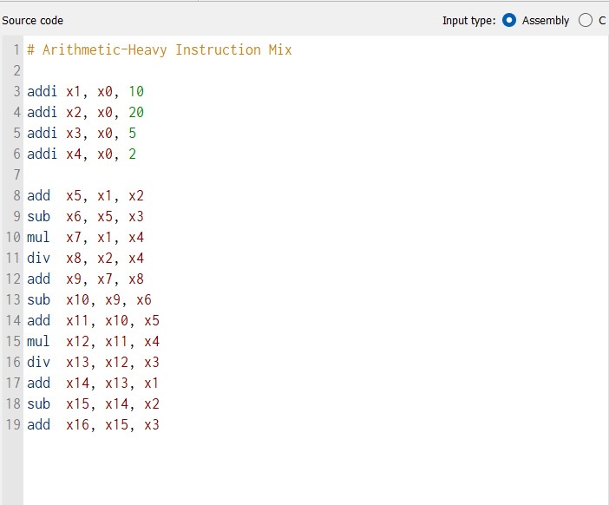
PROGRAM 1 — ARITHMETIC
Arithmetic-Heavy Instruction Mix
16 instructions | ADD, SUB, MUL, DIV, ADDI — no memory, no branches
KEY CHARACTERISTICS
Register-to-register operations only: ADDI, ADD, SUB, MUL, DIV
No data memory access — zero LW/SW instructions
No branch or jump — completely sequential control flow
Data forwarding resolves most RAW hazards without stalls
16 instructions executed in 20 clock cycles
EXPECTED BEHAVIOR
Minimal pipeline stalls, efficient ALU utilization, and the lowest CPI among all three programs. Pipeline fills quickly and remains nearly full throughout execution.
07

Slide 8
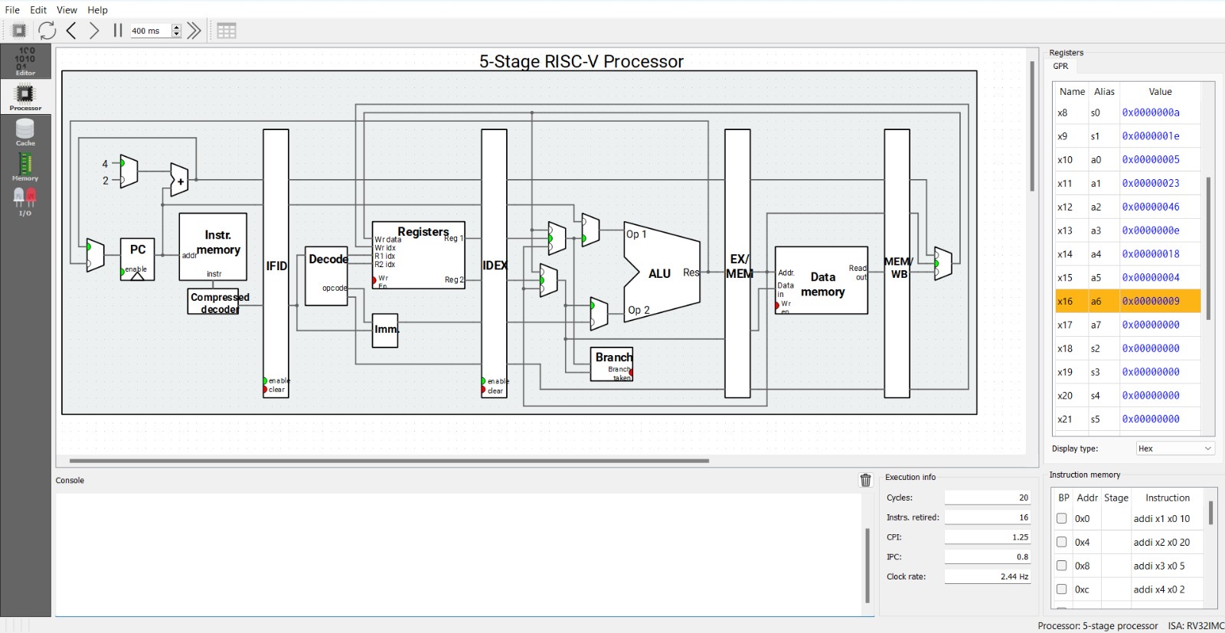
PROGRAM 1 — RESULTS
Arithmetic-Heavy: Simulation Output
Fig 2 — Ripes 5-Stage Processor Simulation
20
Total Clock Cycles
16
Instructions Retired
1.25
CPI (Cycles Per Instruction)
0.800
IPC (Instructions Per Cycle)
08

Slide 9
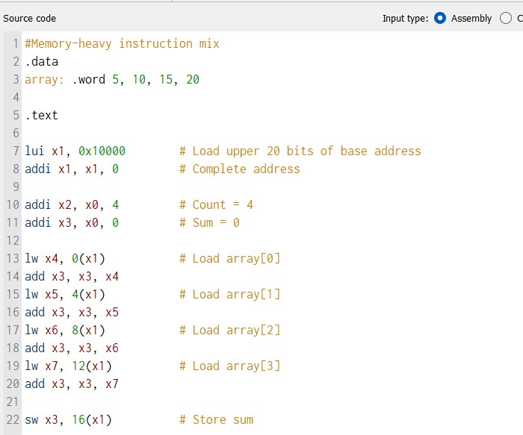
PROGRAM 2 — MEMORY
Memory-Heavy Instruction Mix
13 instructions | LUI, LW, ADD, SW — array load-accumulate-store
KEY CHARACTERISTICS
Uses .data section: array .word 5, 10, 15, 20
Base address loaded using LUI + ADDI (hardware setup)
Four LW instructions each followed by dependent ADD — load-use hazards
One SW instruction stores final sum to memory
13 instructions in 21 cycles — load-use stalls add extra cycles
LOAD-USE HAZARD
Each LW → ADD pair forces a 1-cycle stall because loaded data isn't available until end of MEM stage, but forwarding can only go back to EX. Final x3 = 0x32 = 50 (5+10+15+20 ✔).
09

Slide 10
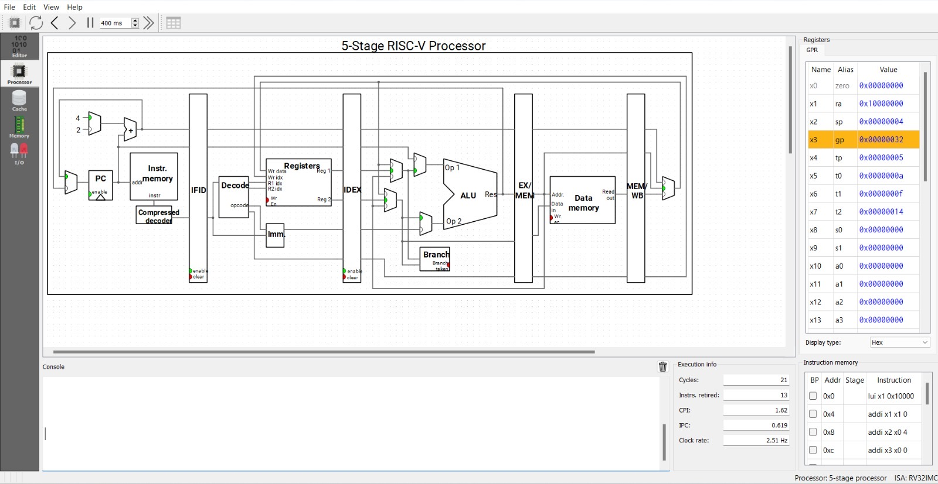
PROGRAM 2 — RESULTS
Memory-Heavy: Simulation Output
Fig 4 — Ripes 5-Stage Processor Simulation
21
Total Clock Cycles
13
Instructions Retired
1.62
CPI (Cycles Per Instruction)
0.619
IPC (Instructions Per Cycle)
10

Slide 11
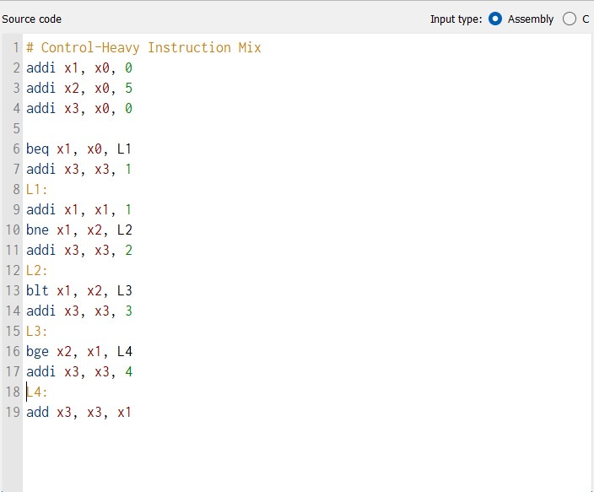
PROGRAM 3 — CONTROL
Control-Heavy Instruction Mix
9 instructions | BEQ, BNE, BLT, BGE — maximum control hazards
KEY CHARACTERISTICS
Four different branch types: BEQ, BNE, BLT, BGE
Multiple labels: L1, L2, L3, L4 define branch targets
Each taken branch flushes 1–2 incorrectly fetched instructions
Control hazards dominate pipeline — branches = 44% of instruction stream
Only 9 instructions but 21 clock cycles — severe CPI degradation
EXPECTED BEHAVIOR
Highest CPI due to frequent pipeline flushes. Each taken branch discards partially-fetched instructions, causing repeated pipeline restart overhead.
11

Slide 12
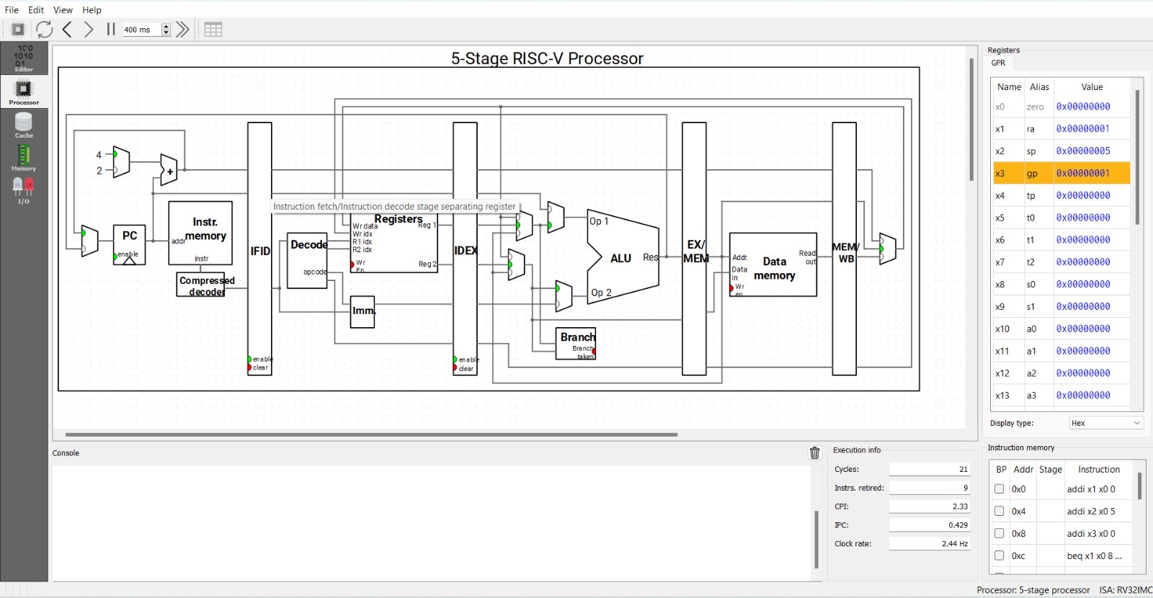
PROGRAM 3 — RESULTS
Control-Heavy: Simulation Output
Fig 6 — Ripes 5-Stage Processor Simulation
21
Total Clock Cycles
9
Instructions Retired
2.33
CPI (Cycles Per Instruction)
0.429
IPC (Instructions Per Cycle)
12

Slide 13
EXPERIMENTAL RESULTS
CPI Comparison Across All Programs
Data recorded directly from Ripes Execution Info panel
CYCLES
INSTRUCTIONS
CPI
IPC
EFFICIENCY
FINAL REG
ARITHMETIC
20
16
1.25
0.800
80%
x16 = 0x9
CYCLES
INSTRUCTIONS
CPI
IPC
EFFICIENCY
FINAL REG
MEMORY
21
13
1.62
0.619
62%
x3 = 0x32
CYCLES
INSTRUCTIONS
CPI
IPC
EFFICIENCY
FINAL REG
CONTROL
21
9
2.33
0.429
43%
x3 = 0x1
13

Slide 14
RESULT ANALYSIS
Analysis & Discussion
Why each instruction mix performs differently
CPI COMPARISON
HAZARD TYPE SUMMARY
Arithmetic CPI = 1.25
Arithmetic
Hazard: RAW (data)
Handling: Forwarding
80% efficiency — data forwarding resolves most RAW hazards
CPI Impact: Low
Memory CPI = 1.62
Memory
Hazard: Load-Use
Handling: 1-cycle stall
62% efficiency — 4 load-use stalls from LW→ADD patterns
CPI Impact: Medium
Control CPI = 2.33
Control
Hazard: Branch flush
Handling: Pipeline flush
43% efficiency — branch flushes dominate (44% branch mix)
CPI Impact: High
KEY FINDING: Arithmetic CPI (1.25) < Memory CPI (1.62) < Control CPI (2.33) — Control-heavy programs are 86.4% slower than Arithmetic in terms of CPI
14

Slide 15
CONCLUSION
Key Findings
CPI = 1.25
80% efficiency
CPI = 1.62
62% efficiency
CPI = 2.33
43% efficiency
Arithmetic-Heavy
Memory-Heavy
Control-Heavy
Data forwarding resolves most RAW hazards. Near-ideal pipeline efficiency. Best-case CPI scenario.
Load-use hazards cause 30% CPI increase. Each LW→ADD pair costs one extra stall cycle unavoidable by forwarding.
Branch flushes cause 86% CPI increase over arithmetic. Frequent pipeline restarts are the dominant bottleneck.
15
MES College of Engineering, Kuttippuram | Dept. of AI & DS | Mini Project 2025–2026 | Guide: Sherik K. K.

Slide 16
IF
THANK
ID
YOU
EX
for your attention
MEM
MES College of Engineering, Kuttippuram
Department of Artificial Intelligence and Data Science
Mini Project — B.Tech AI & DS | 2025–2026
WB
Guide: Sherik K. K., Assistant Professor
Presented by:
Fathima Minsha
Farha Fathima
Fathima Hafna Sherin
Fathimath Naja
Hasna TK
Ridhin Muhammed
16

Slide 17
Q
A
QUESTIONS &
ANSWERS
We welcome your questions!
MES College of Engineering, Kuttippuram | Dept. of AI & DS | 2025–2026
17

